Slide 1
Surface area and volume
Year 11 Biology
Bremer SHS

Slide 2
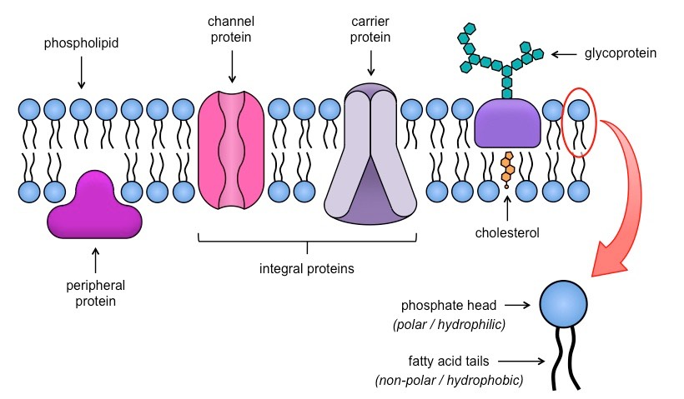
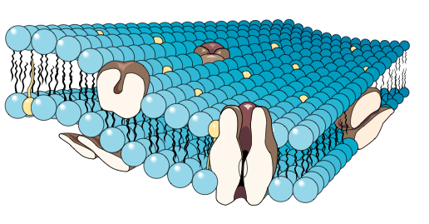
Anticipatory set
Brainstorm a list of molecules that are transported across a cell membrane.

Slide 3

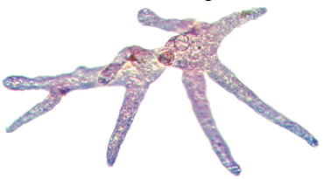

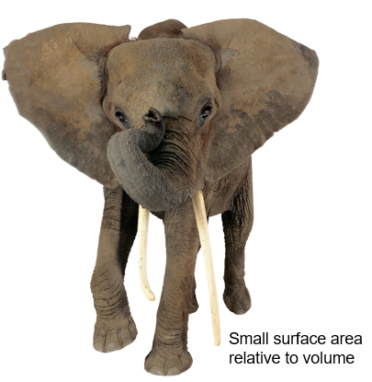
Limitations to cell size
A small organism has a large surface area relative to its volume. For these organisms, diffusion is an effective way to transport materials into and out of the cell.
As an organism becomes larger, its surface area decreases relative to its volume and diffusion ceases to be an effective way to exchange materials with the environment.

Slide 4
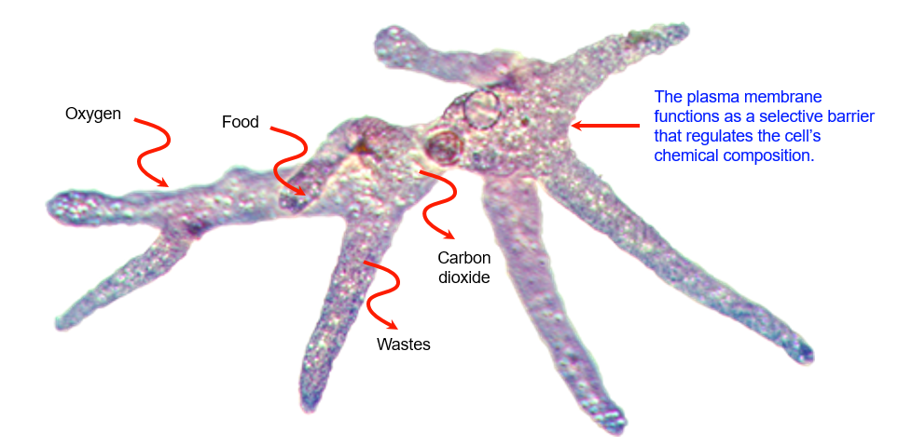
Surface area available for diffusion
The small size of single-celled protists such as Amoeba, provides a large surface area relative to the cell’s volume.
This is adequate for materials to be moved directly into and out of the cell by diffusion or active transport.

Slide 5
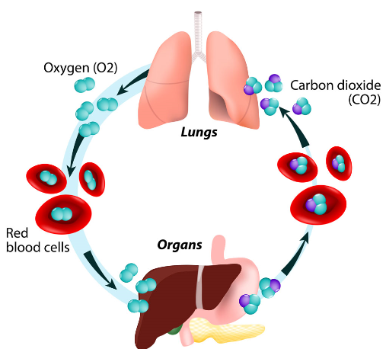
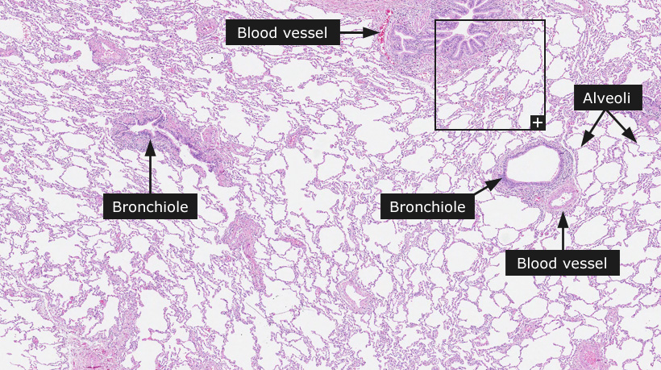
Surface area available for diffusion
To overcome the problems of small cell size, plants and animals became multicellular.
Large organisms have a small surface area compared to their volume but have evolved various adaptive features to increase their effective surface area.

Slide 6
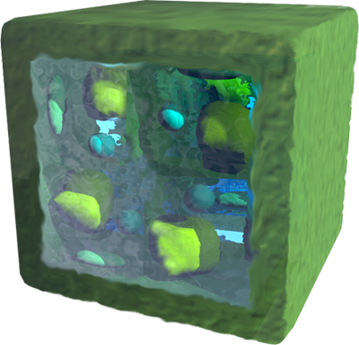
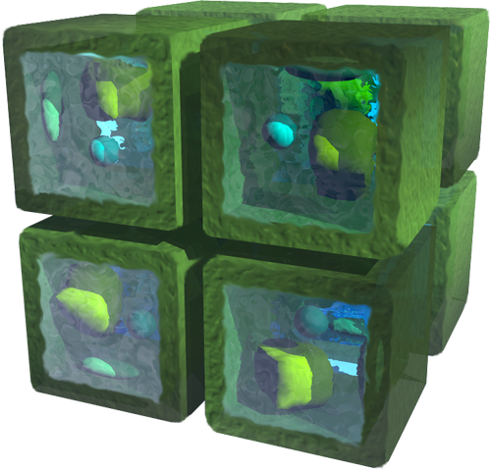
Surface area : Volume
The eight small cells (below right) and the single large cell (above right) have the same total volume, but their surface areas are different.
The small cells together have twice the total surface area of the large cell, because there are more exposed (inner) surfaces.
The surface-area volume relationship has important implications for processes involving transport into and out of cells across membranes.

Slide 7
recap
As cell size increases:
its volume increases at a faster rate than the surface area.
the surface area to volume ratio decreases.
difficulties in exchanging materials at rates adequate to meet demands is experienced.

Slide 8
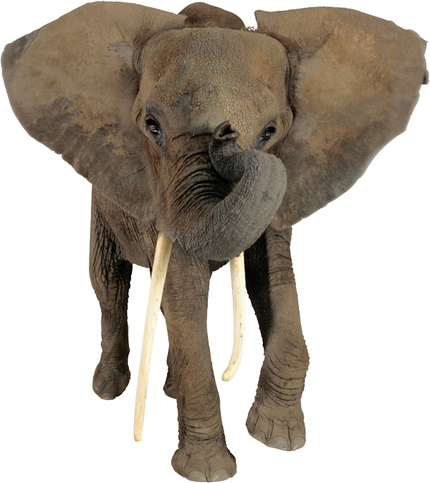
Check for understanding
Adaptive features of a multicellular organism that increase surface area for diffusion include:
Respiratory System
Circulatory System
Digestive System
Heat Loss
Identify adaptive features for increasing surface area in an elephant.

